Slide 1
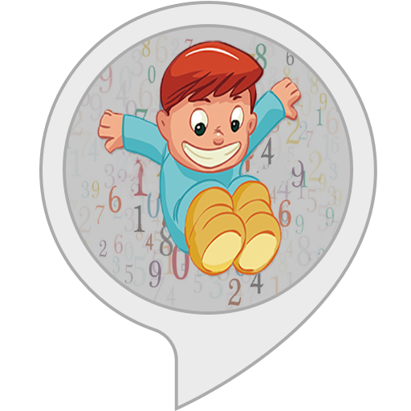

Jump Numbers Team – Ak Skill
An Alexa Skill
BY:
Avi Kathuria

Slide 2
Executive Summary
Take a pause from daily routine and help kids to practice multiplication with a voice skill.
This skill can be played by any age, so no age bar.
The skill works in three modes of difficulty i.e. easy, medium and complex.
In easy mode, user has to say jump if multiple of 5 number is given by alexa else say pass. Similarly, In medium mode, multiples of 3 and 7 and in hard 4, 7 and 9 multiples.
Your scores will rewarded in the game, so keep challenging yourself. Remember that, numbers will be coming in random order.

Slide 3
Problem in Hand
Kids inability to grasp multiplication on random scale
Limited Technical games that can help to make Mathematics strong

Slide 4
Problem Solved
Help Kids to practice multiplication
User can check his/her multiplication power
A fun game based on numbers

Slide 5
Theme – #Problem 1 – Voice Games
My Idea – Jump Numbers
Unique – Not Available on Alexa Skill Store
Engaging – Random numbers keep the momentum
Scoring – Level wise scoring done (6 levels, at present stage)
Badges – Badges will be given as beginner, intermediate and professional.
Simple Interaction – Say Pass or Jump if it’s a multiple of 5, 3, 7, 9*.
Music – Engaging music on given on game over and shooting
Images – Image will guide the whole play for echo show & dot devices

Slide 6
Basic Features
STOP
CANCEL
HELP

Slide 7
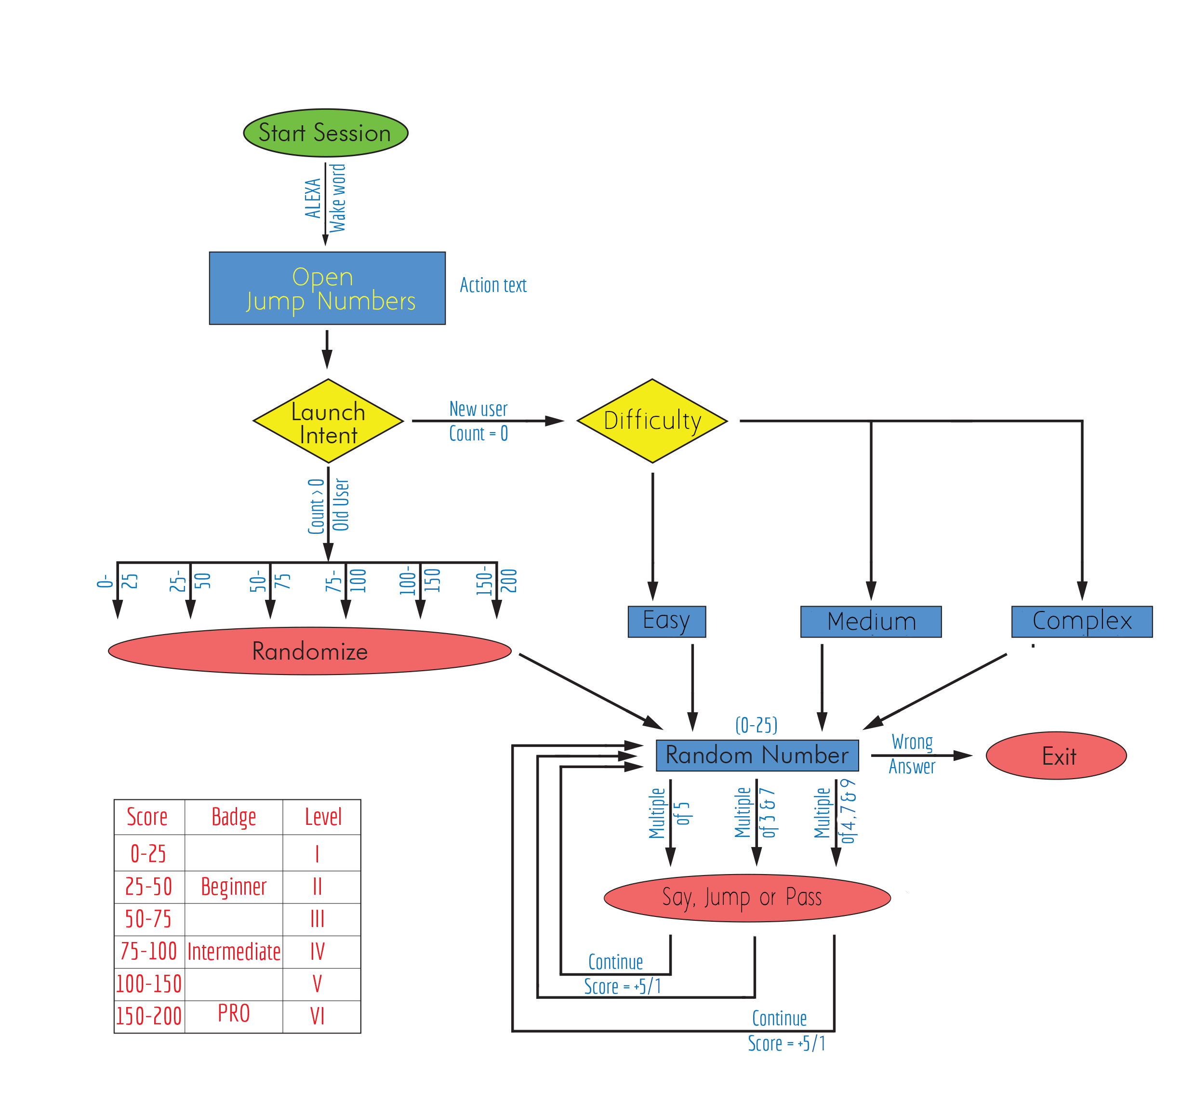
Flow Diagram

Slide 8
Technical Details
Skill ID - amzn1.ask.skill.4fd68e4e-a2d6-413e-bfa9-e36bbb0b48b5
Backend – Node.js
Database – Amazon Dynamo db Services
Storage – Amazon S3 Management Console
Computation – Amazon Lambda Function
Email Id – avikathuria21@gmail.com

Slide 9
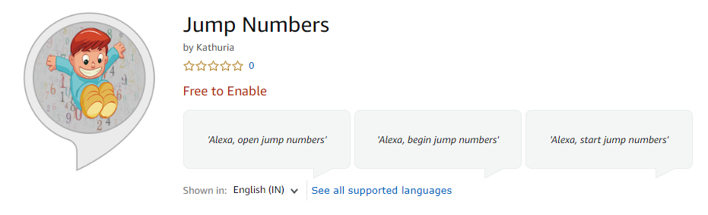
Demo Link
https://www.amazon.in/dp/B07RT4D52S/ref=sr_1_1?keywords=jump+numbers&qid=1557950822&s=digital-skills&sr=1-1-catcorr

Slide 10
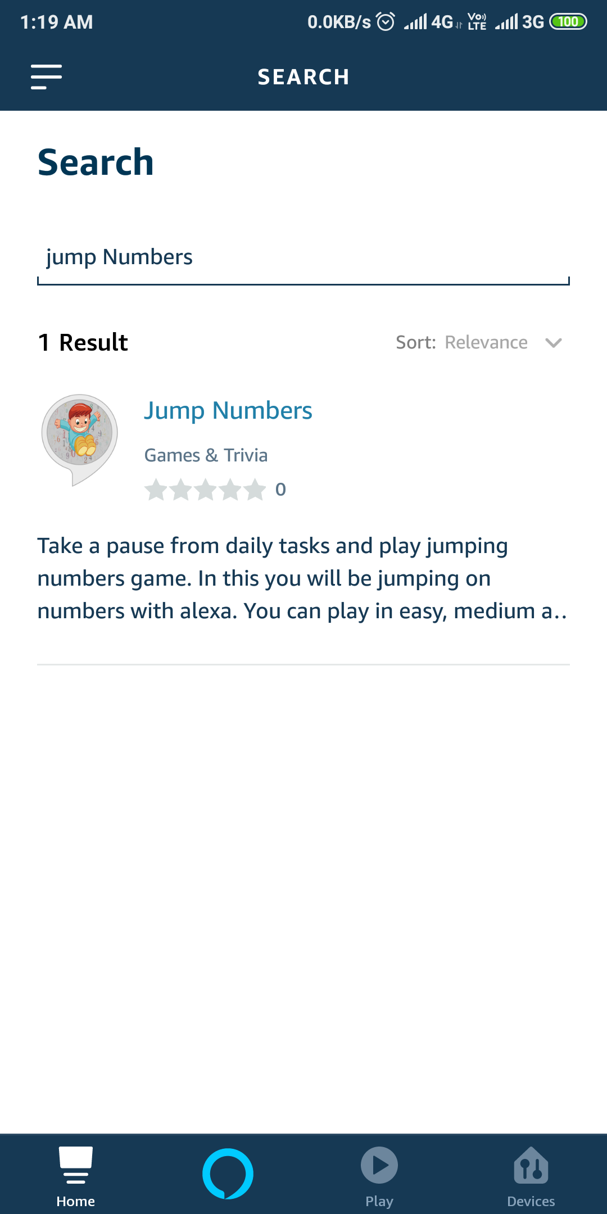
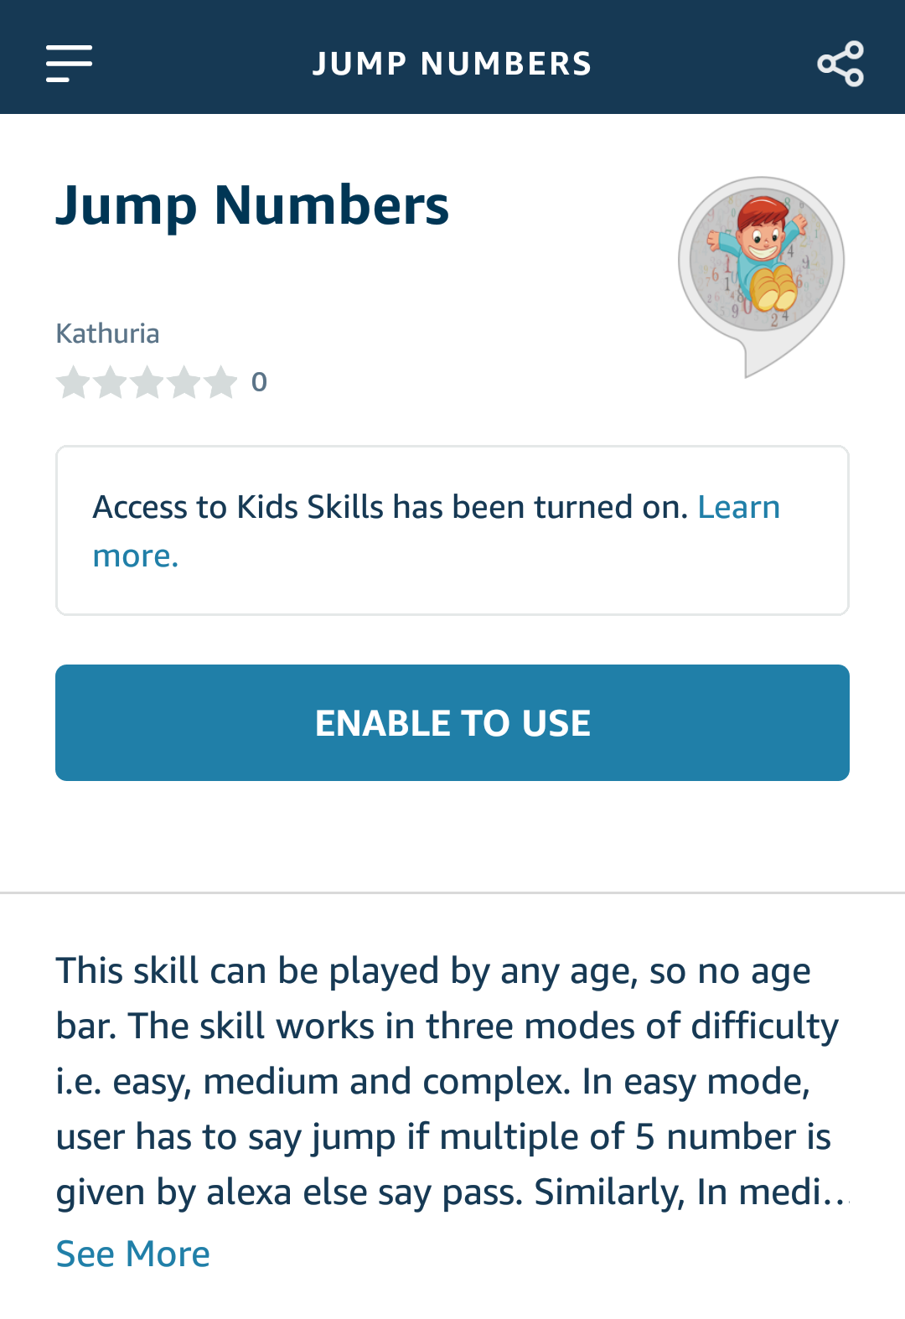
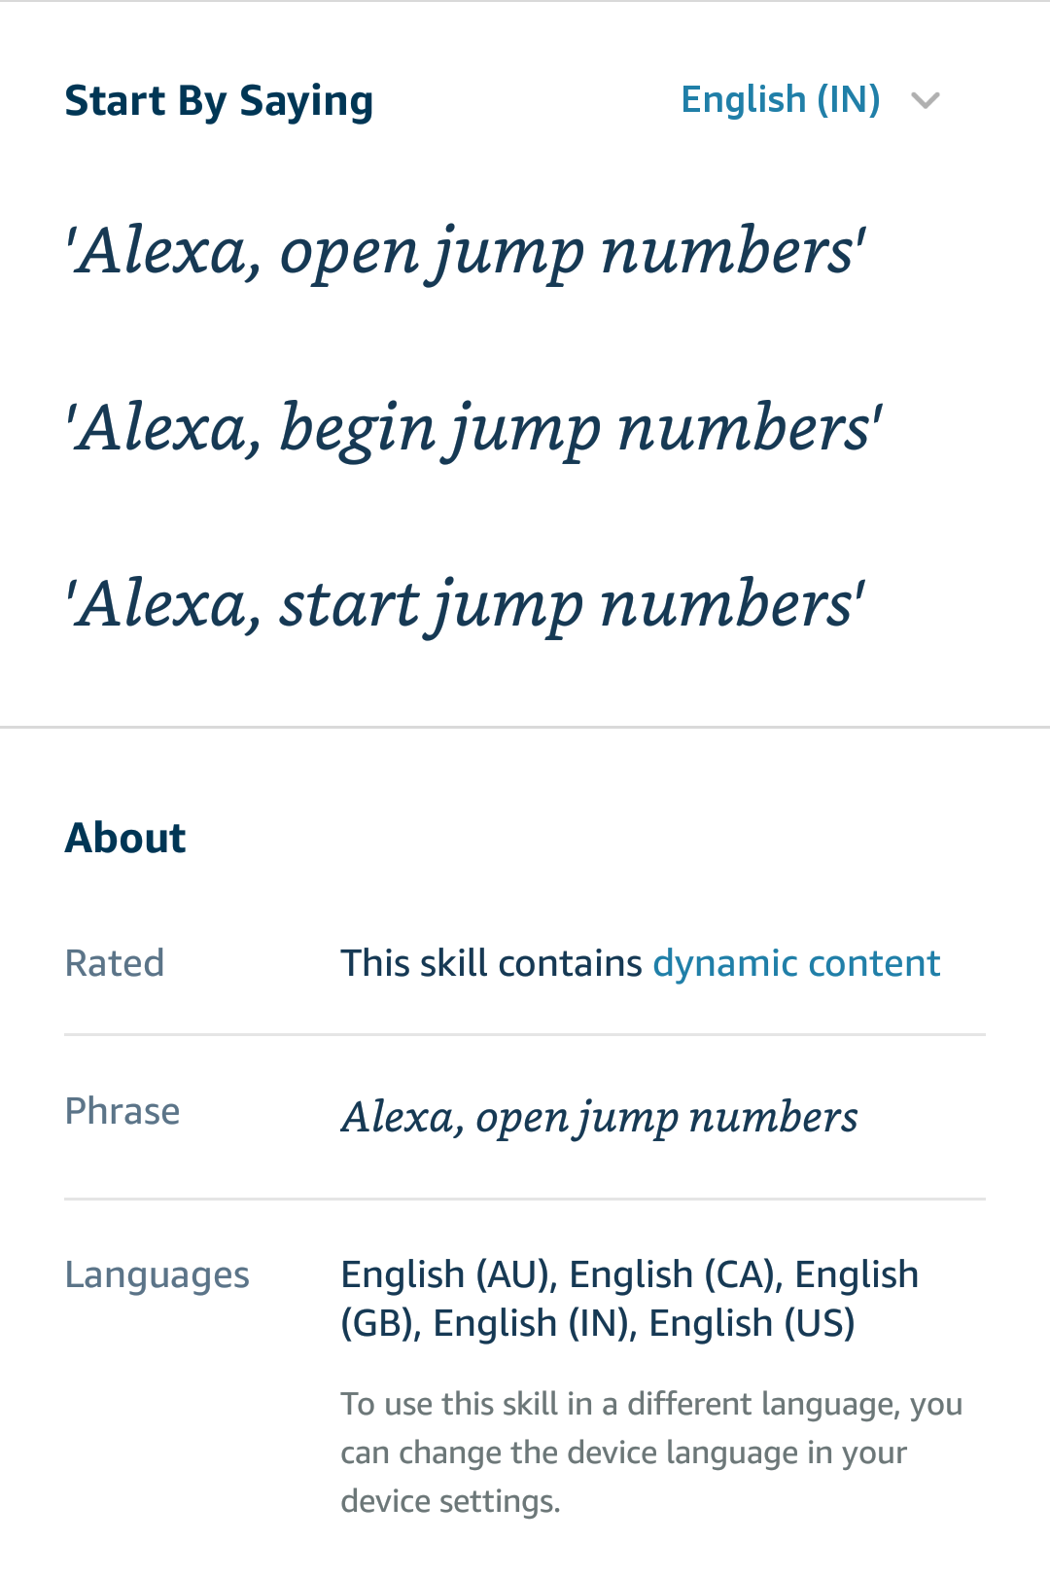
Screenshots

Slide 11
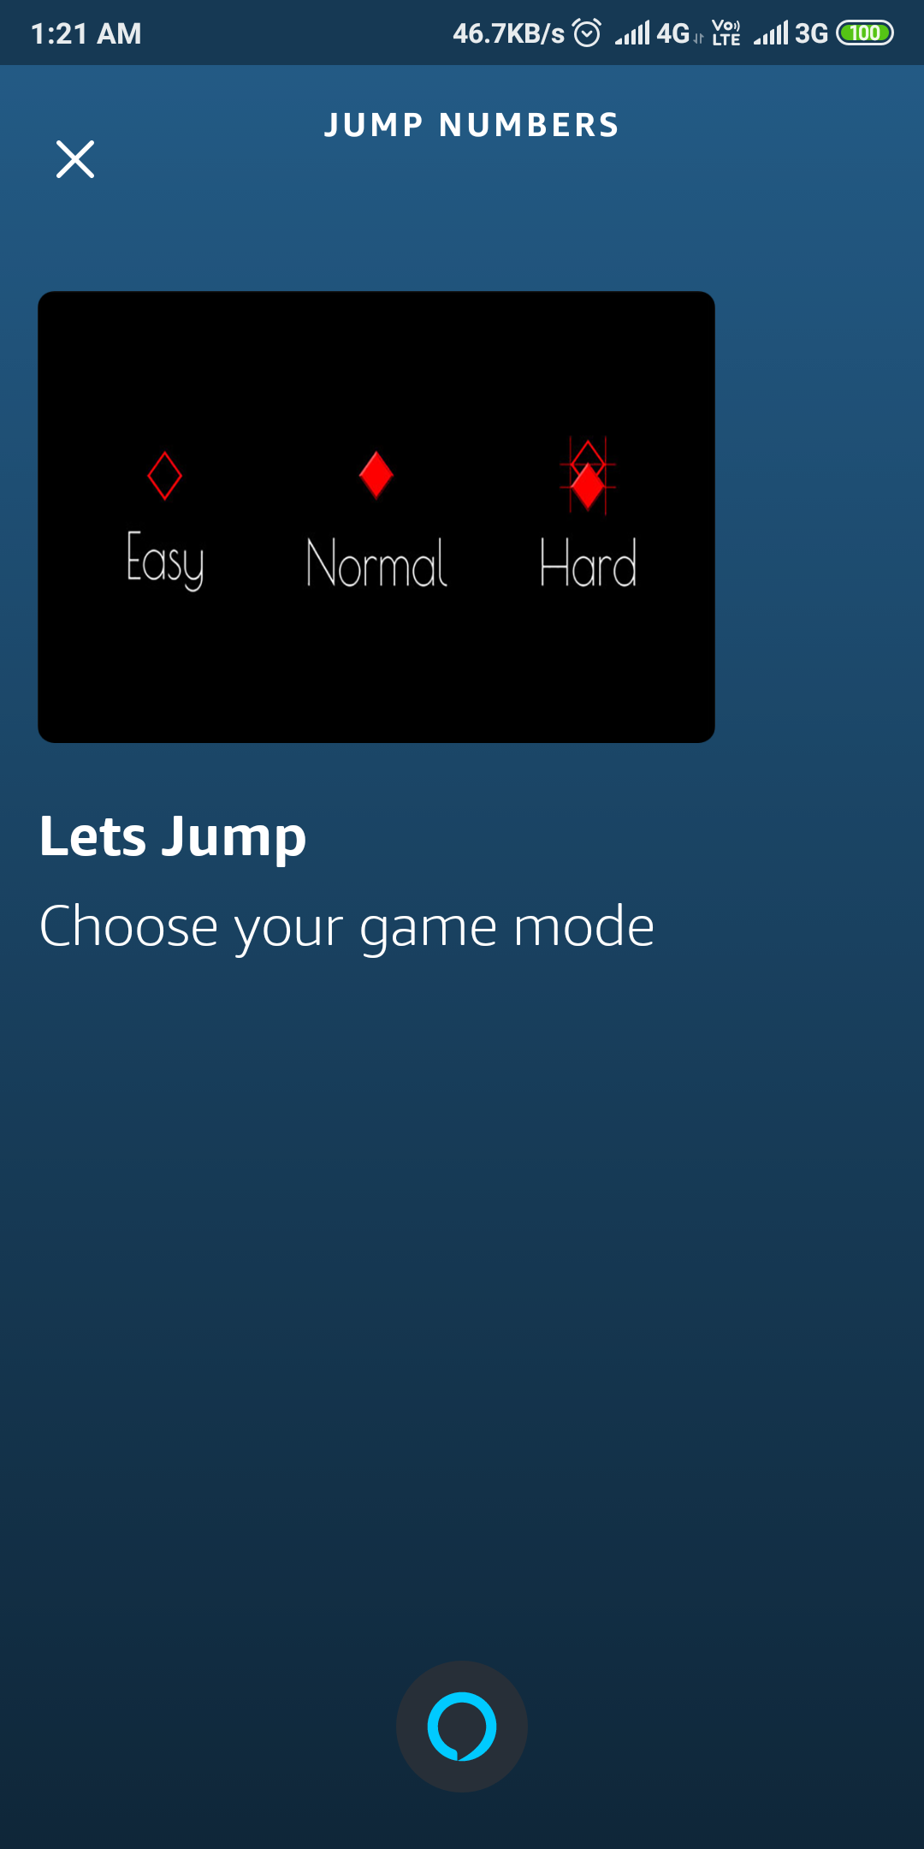
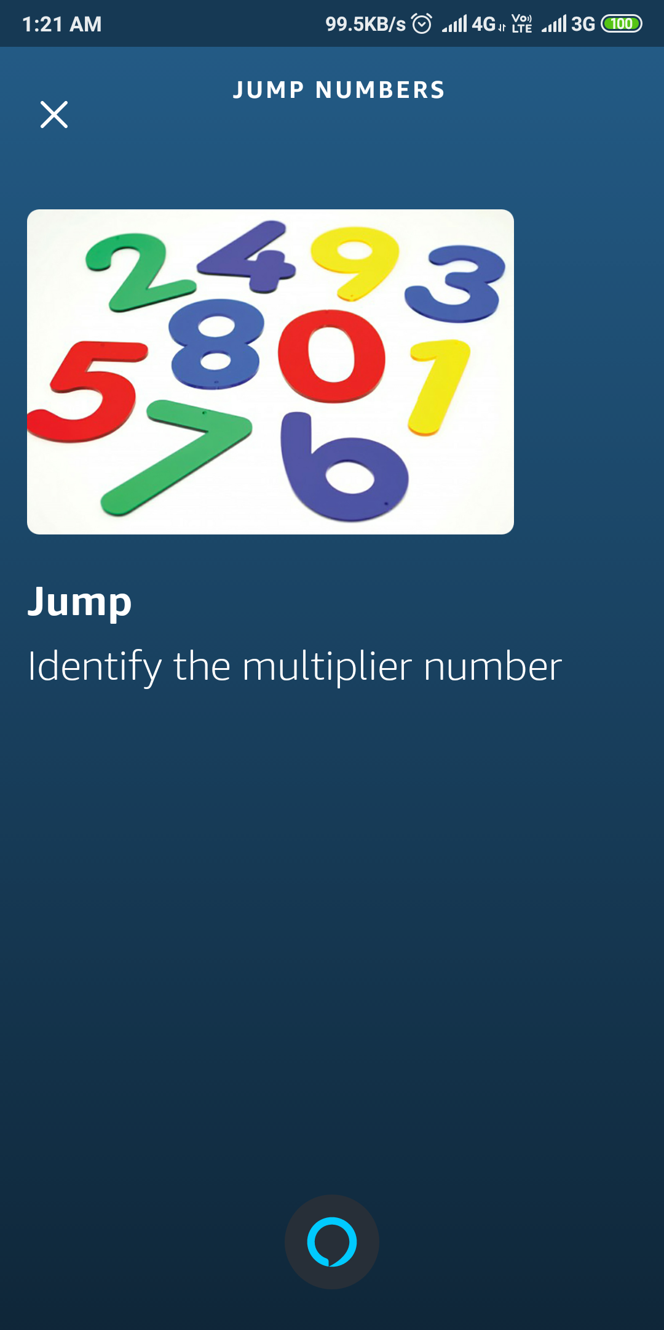
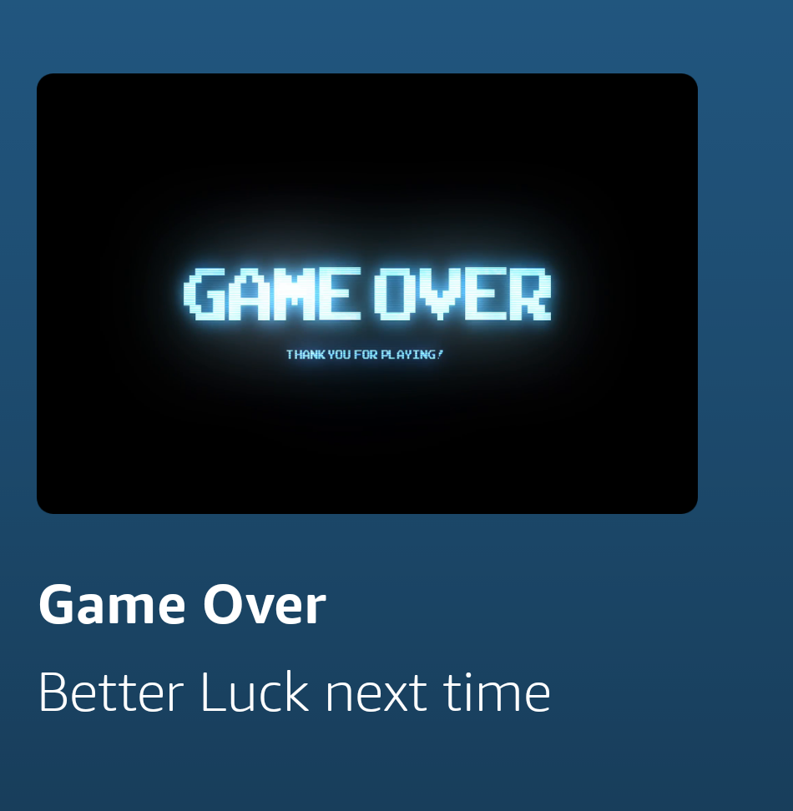
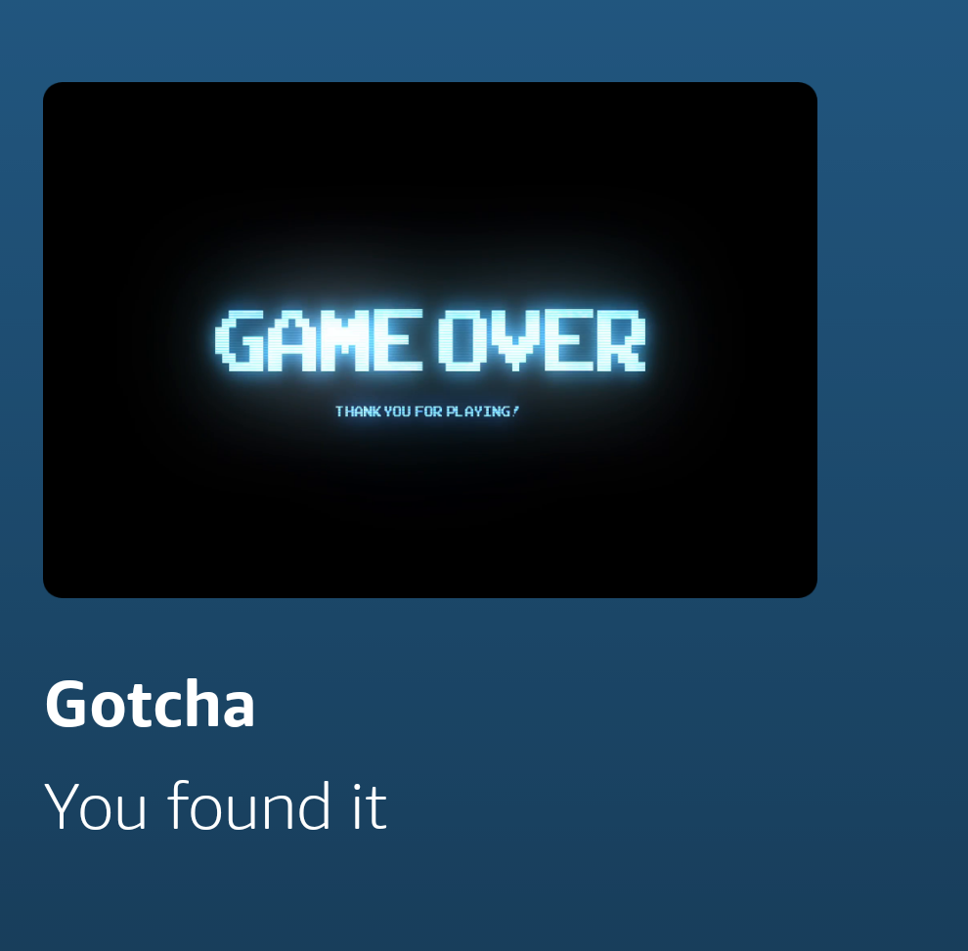
Game Play

Slide 12

Why to Select for Finals???
Skills are made to solve a problem
Problem solution must be helpful and as much easy as possible
Skills for Kids can help them to adapt new technological changes
Developed Voice skills can be helpful for parents to entertain and help their kids to learn
My inspiration is the youth of India that needs daily dose of doing same work in different and easy way
https://www.amazon.in/s?k=Kathuria&i=alexa-skills&ref=nb_sb_noss

Slide 13
Challenges
IDEA (Kids Skill)
Easiest Implementation (Pass/Jump)
Interactive for Kids (Musical effects)

Slide 14
Possible Improvements
Adding New Difficulty modes with more multiplier
User Based Multiplier
Updates based on User Reviews & Feedback

Slide 15
Thank You

